Slide 1

Plant Pulse: Deep Learning for Plant Disease Detection
Presented by OM Prakash Bhagat, Vansh Sehgal, and Divyansh Kumawat under the supervision of Anisha M. Lal, School of Computer Science and Engineering (SCOPE), B.Tech. Computer Science and Engineering, September 2025.

Slide 2

Introduction: The Challenge of Plant Diseases
Plants are vital for food, oxygen, and raw materials but face threats from fungal, bacterial, and viral diseases. These diseases cause visible symptoms like leaf spots and discoloration, reducing photosynthesis and crop yields. Traditional diagnosis relies on expert visual inspection, which is slow, labor-intensive, and error-prone, especially in resource-limited areas. Advances in AI and deep learning offer promising solutions to automate and improve disease detection, supporting sustainable agriculture and food security.
Project - I

Slide 3
Motivation and Scope
Accurate and timely disease detection is critical to prevent crop loss and financial strain on farmers. Many symptoms overlap with nutrient deficiencies or environmental stress, complicating diagnosis. This project leverages deep learning, specifically Convolutional Neural Networks (CNNs), trained on over 65,000 images across 37 disease categories, to automate detection. Additionally, an FAQ chatbot powered by sentence embeddings offers interactive guidance, making the system accessible and practical for farmers, even in low-resource settings.
Project - I

Slide 4

Literature Review: Advances and Limitations
Recent studies show CNN-based models achieving up to 98.98% accuracy in plant disease detection using datasets like PlantVillage. Techniques include semantic segmentation, attention mechanisms, transfer learning, and ensemble models. However, challenges remain such as overfitting, limited generalization to diverse crops, computational complexity, and lack of user-friendly applications. Most models focus on classification without integrating decision-support tools for farmers.
Project - I

Slide 5
Identified Gaps in Current Solutions
Dataset Limitations
Early Symptom Detection
Predominance of small, homogeneous datasets limits real-world applicability due to varying field conditions.
Models struggle to identify subtle or early-stage disease symptoms, impacting timely intervention.
Computational Constraints
User Interaction
High model complexity hinders deployment on low-resource devices common in farming environments.
Lack of integrated interactive tools like chatbots limits practical decision support for farmers.
Project - I

Slide 6
Project Objectives
This research aims to develop a CNN-based plant disease detection model with over 95% accuracy across 10 crop types and 37 disease classes. The system incorporates data augmentation and normalization to enhance robustness. A user-friendly chatbot interface will provide real-time, actionable information to farmers. The model will be evaluated on diverse datasets to ensure applicability in resource-constrained regions, supporting sustainable agriculture through accessible technology.
Project - I

Slide 7
Problem Statement
Plant diseases cause significant crop losses and threaten food security. Current manual diagnostic methods are slow, error-prone, and inaccessible in many regions. Disease symptoms often resemble other stresses, complicating diagnosis. Multiple diseases on a single plant further challenge farmers. An automated, reliable system using CNNs and an FAQ chatbot is needed to improve detection accuracy, reduce farmer burden, and enable timely management, especially in resource-limited settings.
Project - I

Slide 8
Project Plan Overview
Weeks
Activities & Deliverables
1-2
Data collection, preprocessing, augmentation, and normalization. Deliverables: Data Collection Report, Preprocessed Dataset, Documentation.
3-4
Model architecture design with CNN layers, activation functions, and system flow diagrams. Deliverables: Architecture Design Document, Flow Diagrams, Decision Rationale.
5-6
Model training with hyperparameter tuning and checkpointing. Deliverables: Training Logs, Initial Model Checkpoints, Configuration Documentation.
7-8
Testing and validation using accuracy, precision, recall, F1-score, and confusion matrix. Deliverables: Validation Report, Performance Analysis.
9-10
Fine-tuning, experiments with transfer learning and regularization. Deliverables: Final Performance Report, Recommendations.
Final Stage
Report compilation and presentation preparation. Deliverables: Final Report, Presentation Slides, Feedback.
Project - I

Slide 9
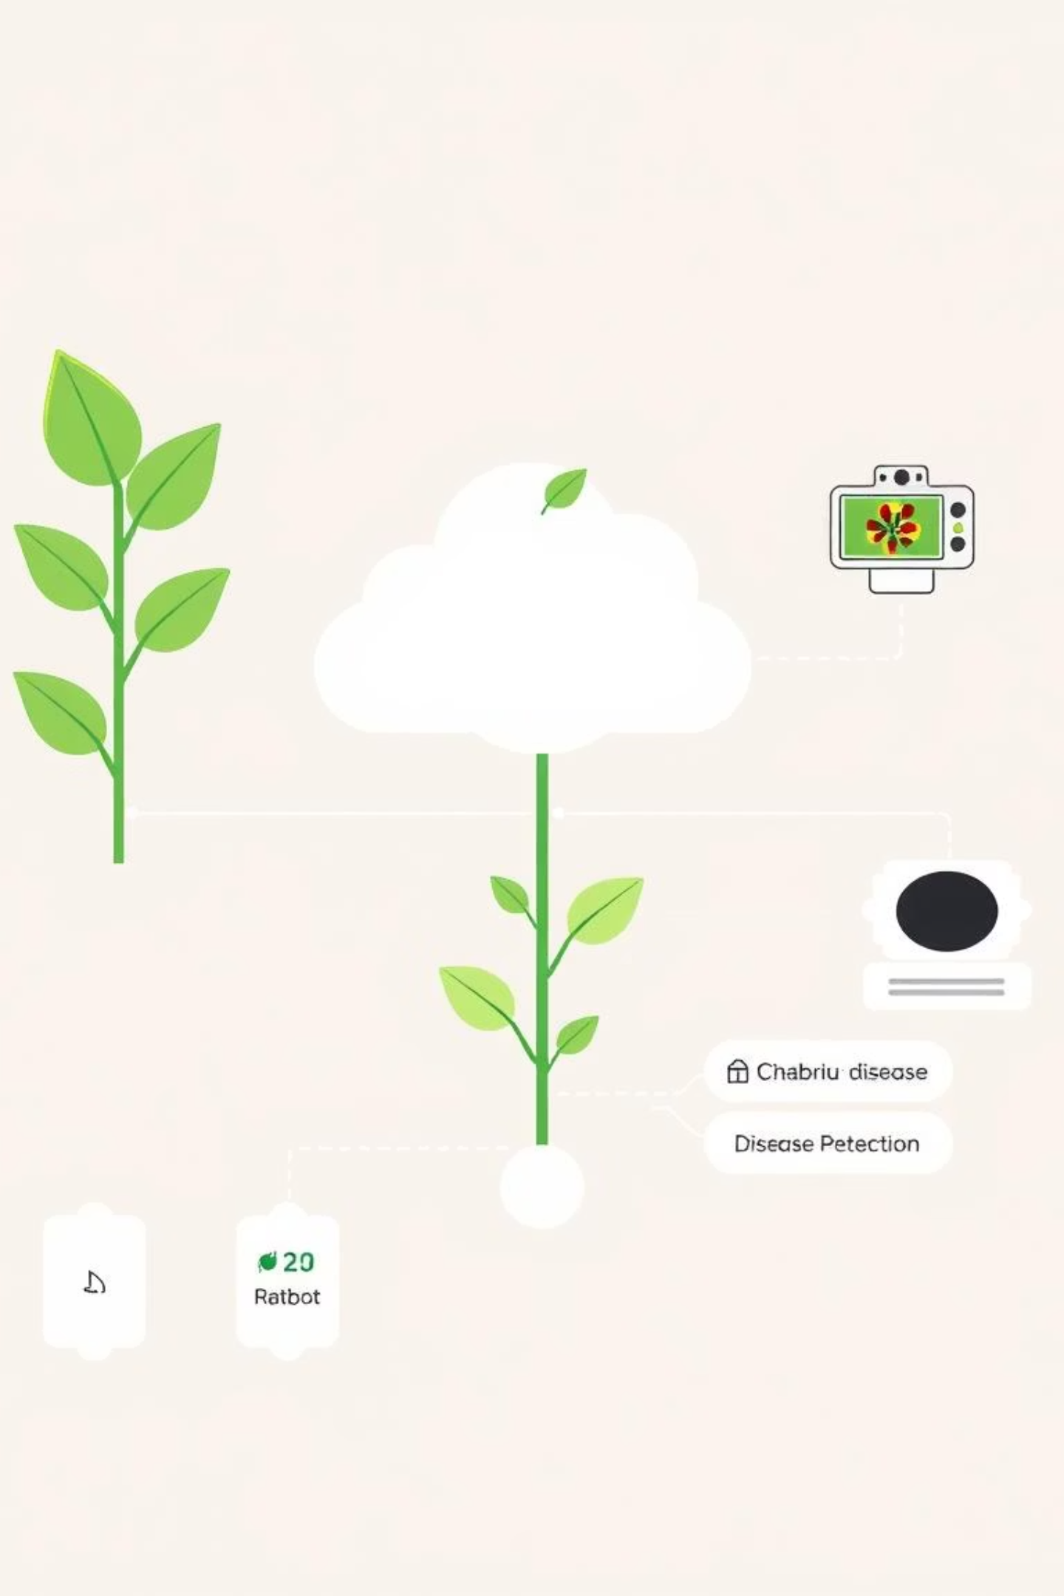
System Design and Architecture
The system architecture integrates image input, preprocessing, CNN-based feature extraction, classification via Softmax, and an FAQ chatbot interface. Data flows from image acquisition through augmentation and normalization to the CNN model, which outputs disease predictions. The chatbot uses sentence embeddings to interpret user queries and provide tailored guidance. The design supports scalability, real-time inference, and usability on low-resource devices.
Project - I

Slide 10

Conclusion and Future Directions
This project demonstrates a modern, deep learning-based approach to plant disease detection with high accuracy and practical usability. By combining CNNs with an interactive chatbot, it addresses key gaps in current solutions, offering farmers accessible, timely, and reliable disease management tools. Future work includes expanding datasets for broader crop coverage, optimizing models for edge devices, and enhancing chatbot capabilities for personalized agricultural advice.
Project - I

